Slide 1
Genetic Drift & Gene Flow

Slide 2
Evolution
Mutation
Non-random changes to allele frequency of population
Random changes to allele frequency of population
Variation in Gene Pool
Variation in Populations
Natural Selection
Sexual Selection
Artificial Selection (Selective breeding)
Genetic Drift
Bottleneck Effect
Founder Effect
Mechanisms of Evolution
Microevolution
Gene Flow

Slide 3
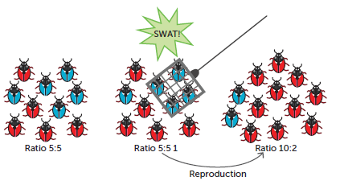
Syllabus:
In addition to environmental selection pressures, sexual selection, mutation, gene flow and genetic drift can contribute to changes in allele frequency in a population gene pool
Describe how genetic drift and gene flow can contribute to changes in allele frequency in a populations gene pool (evolution)
Heredity
Essential
Question:
BIOLOGY WA UNITS 3&4
Chapter 9 Mechanisms of Evolution and Speciation pg. 293-308
Questions
Set 9.4 pg. 307 Q 1-4 Genetic Drift
Set 9.5 pg. 308 Q 1-4 Gene Flow
BIOZONE Activity Number:
Theory of Evolution 203,
Mechanisms of Natural Selection 204,
Gene Pool 205, 206, 207,
Types of Natural Selection 208, 211, 212, 213
Adaptations & Fitness 209, 215, 216, 217, 218
Genetic Drift 219, 220, 221
Key Terms 222
Topic Question 1:
Define genetic drift

Slide 4
Topic Question 2:
Describe the effect of genetic drift on the genetic diversity of a population
Topic Question 3:
Name the 2 extreme examples of genetic drift

Slide 5
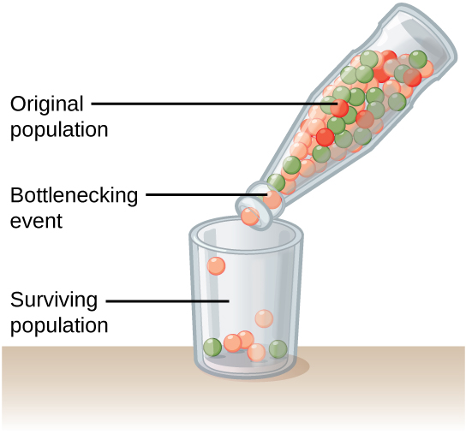
Topic Question 4:
Describe bottleneck effect
Topic Question 5:
Describe the analogy of the bottle used to depict the bottleneck effect

Slide 6
Topic Question 6:
Describe the effects on the population of the bottleneck effect

Slide 7
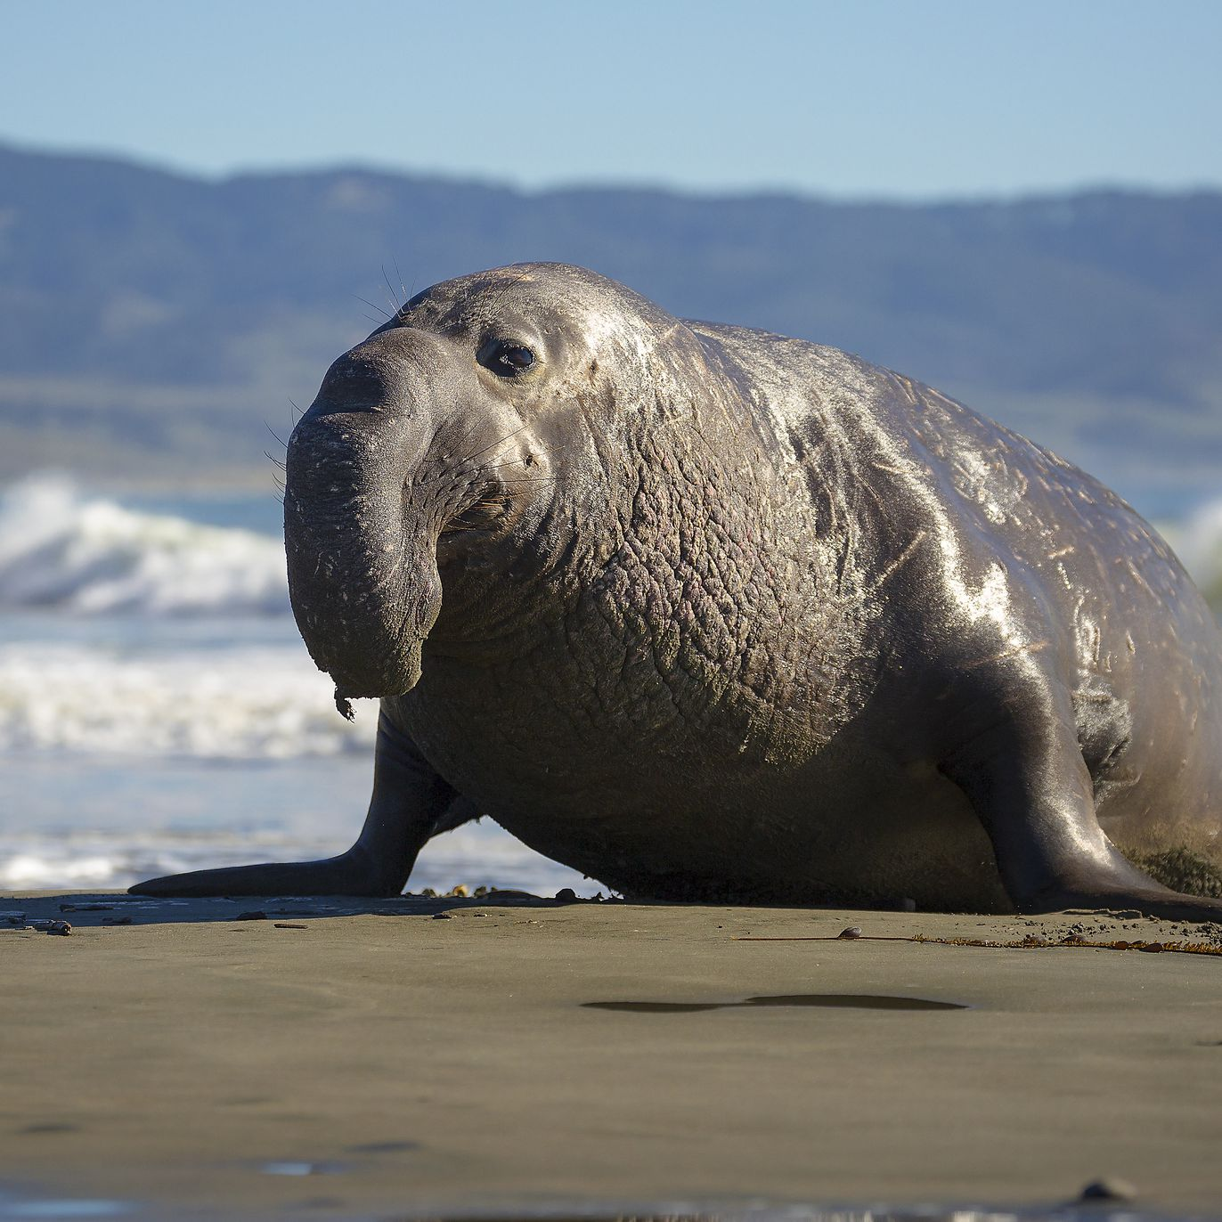
Topic Question 7:
Describe an example of the bottleneck effect
Name of animal | Bottlenecking Event | Description of surviving population and Effect of the bottleneck event on the population
Cheeter
Elephant Seal

Slide 8
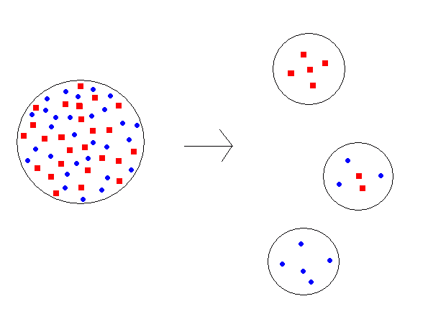
Topic Question 8:
Describe the founder effect
(Read your text book to add examples of the founder effect to your description)
Examples of the Founder Effect

Slide 9
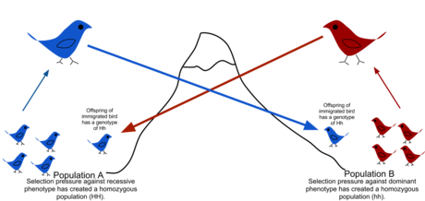
Topic Question 9: Describe how gene flow is a mechanism of evolution
Practice Question
Gene flow and genetic drift also contribute to allele frequency changes in gene pools.
Describe the differences between these two processes of evolution. (2 marks)

Slide 10
Topic Question 10: Compare natural selection and genetic drift

Slide 11
Sum it up!
Draw a Concept map or mind map of the four mechanisms of evolution, making links to heredity (mutation, variation, inheritance) to summarise and make connections to what you have learnt

